Slide 1
Computer networks and network attacks
Artem Lenskiy
artem.Lenskiy@anu.edu.au

Slide 2
Content
Part 1: ”Lower layers” of the network stack
Review of the TCP/IP stack
Datalink layer
Internet Protocol
Internet Control Message Protocol
Practice: ifconfig, arp, traceroute
Address Resolution Protocol
ARP man-in-the-middle-attack
Part 2: Transport layer
Transmission Control Protocol
A SYN-spoofing attack
Practice: tcpdump, nmap

Slide 3
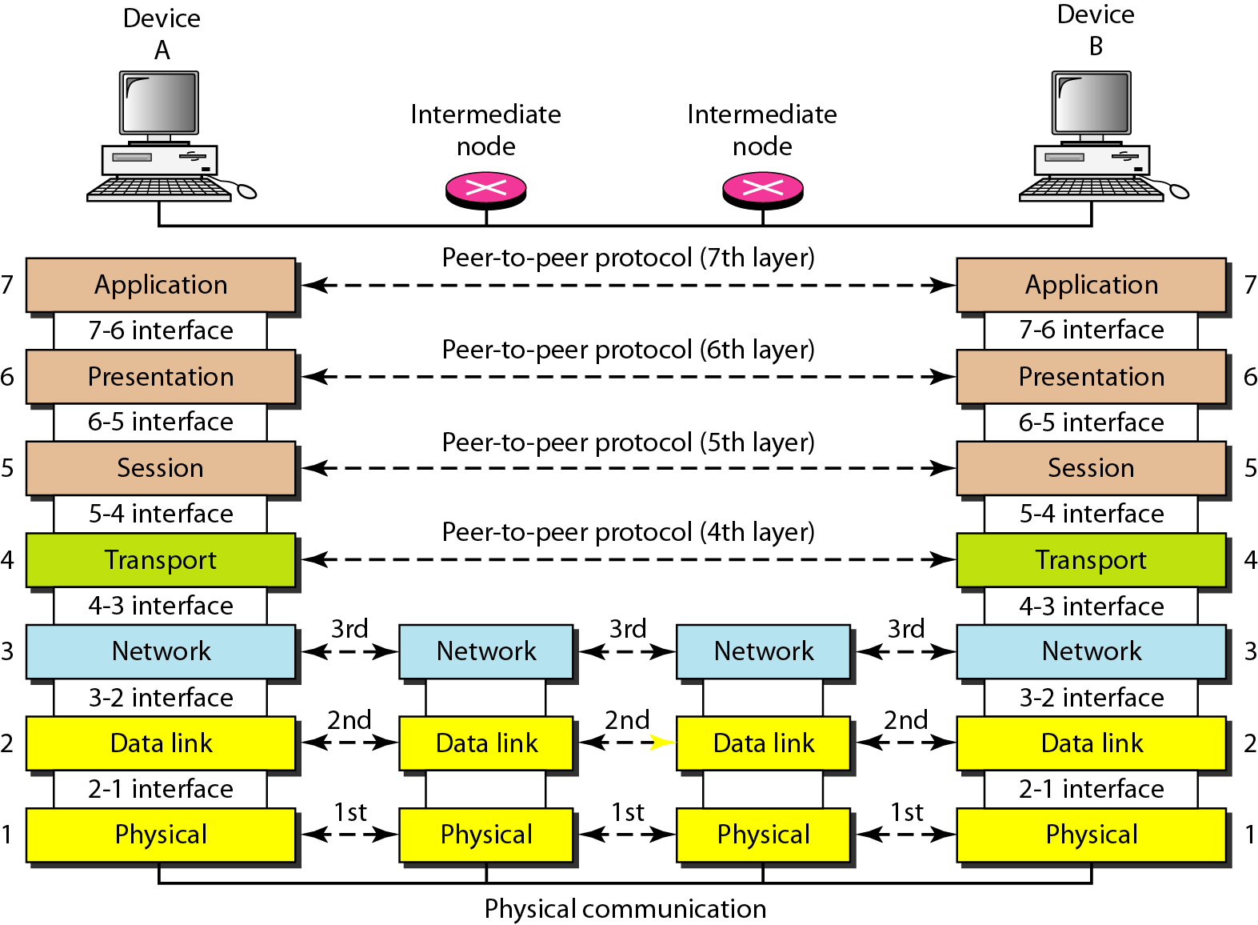
Review of the OSI and TCP/IP stacks
OSI
TCP/IP
Functions
provides service to user
compression and encryption
dialog control and synchronization
reliable delivery
delivery of individual packets
moving frames
movements of individual bits
application
transport
internet
network access

Slide 4
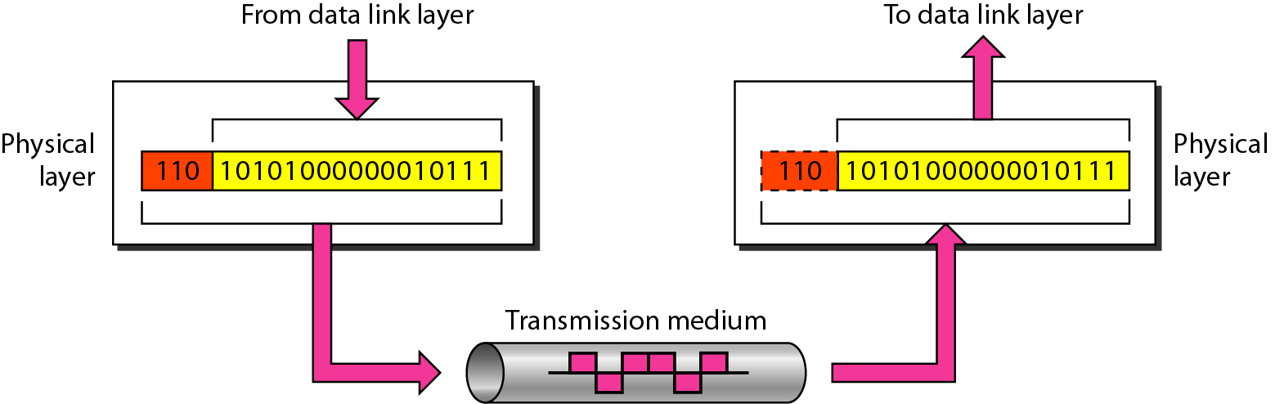
Physical (PHY) Layer
Responsible for movements of individual bits from one node to the corresponding other(s)
Physical characteristics of interfaces and medium
Representation of bits (encoding)
Data rate
Synchronization
Topology (mesh, star, ring, bus, …)
Transmission mode (simplex, half-duplex, …)

Slide 5
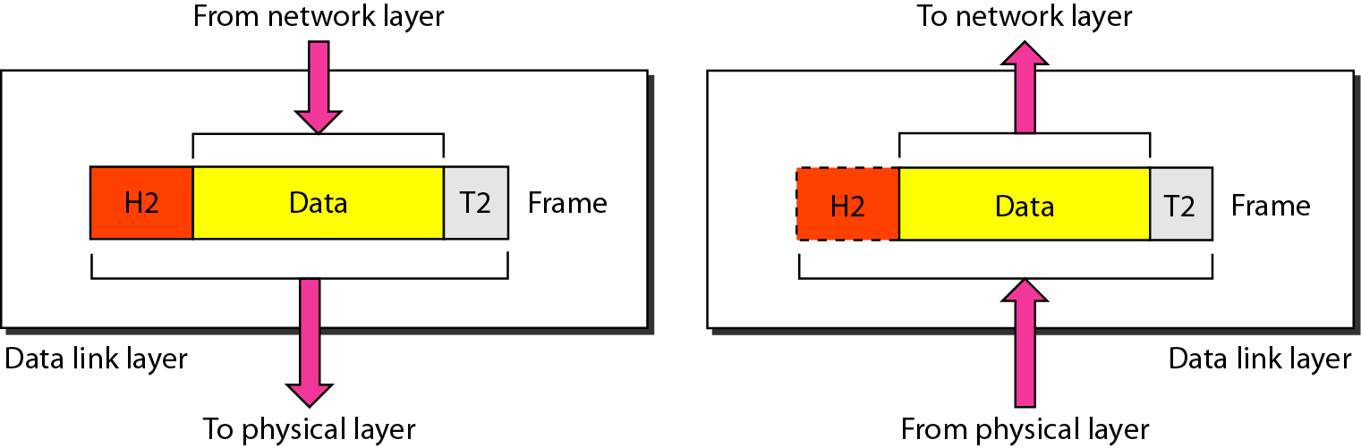
Data Link Layer
Responsible for moving frames from one node to the corresponding other(s)
Framing (Divides the strep into data units)
Physical addressing (of the sender/receiver)
Flow control (avoid overwhelming)
Error control (detect damaged/lost frames)
Access control

Slide 6
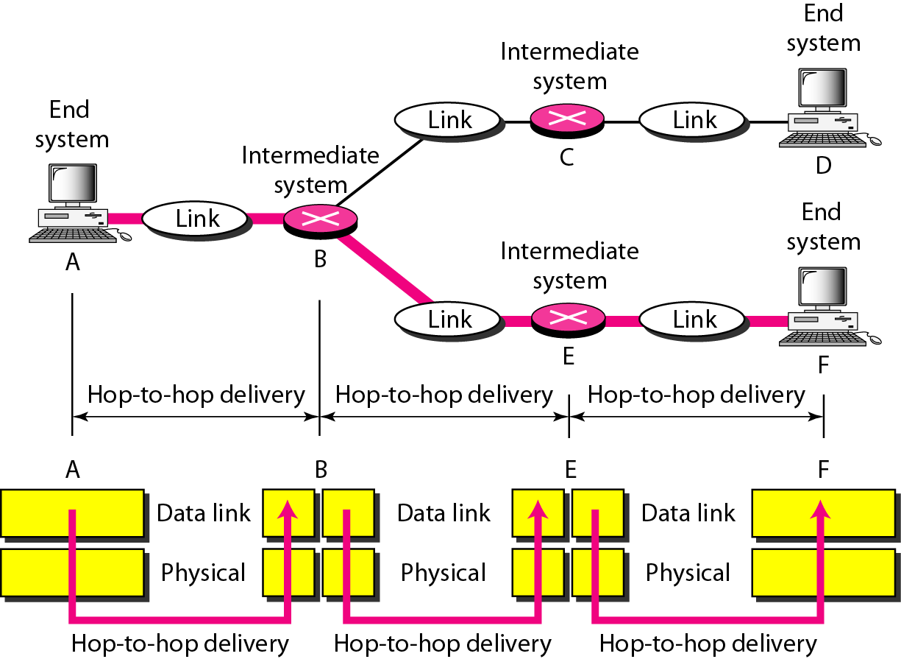
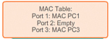
Hop-to-hop delivery
PHY and data link layers responsible for one-hop (or hop-to-hop) delivery (operate “locally”)
The switch uses the information in the physical address table to send frames destined for a specific device out the port, which has been assigned to that device.
https://www.ciscopress.com/articles/article.asp?p=2181835&seqNum=5

Slide 7
Data Link Layer: Ethernet (standardized in 1983 as IEEE 802.3)
Ethernet provides services up to and including the data link layer
The original 10BASE5 Ethernet uses coaxial cable as a shared medium, while the newer Ethernet variants use twisted pair and fiber optic links in conjunction with switches.
Notes:
Ethernet is a family of computer networking technologies that operates at the physical and datalink layers. Ethernet was commercially introduced in 1980 and first standardized in 1983 as IEEE 802.3
IEEE 802.3 is a working group and a collection of Institute of Electrical and Electronics Engineers (IEEE) standards produced by the working group defining the physical layer and data link layer's media access control (MAC) of wired Ethernet.

Slide 8
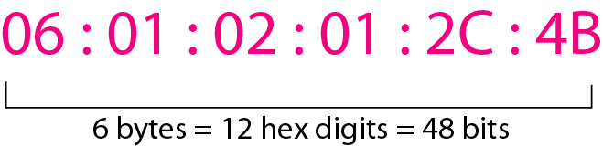
Data Link Layer: Ethernet frame structure
Ethernet frame
header
trailer
Preamble
---------------
7 bytes
Start of Frame Delimiter
(1 byte)
destination address
---------------
6 bytes
source address
---------------
6 bytes
length
---------------
2 bytes
Data
---------------
46 - 1500 bytes
Pad
---------------
1500 - length
Frame Check Seq.
---------------
4 byte
control information
Addressing
6-byte physical address, in hexadecimal notation
Usually dedicated to network interface card (NIC)

Slide 9
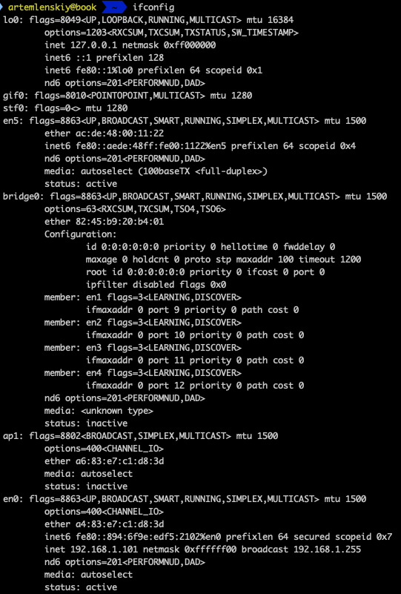
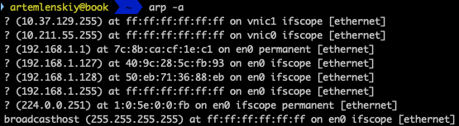
Practice
To determine your physical address use:
ifconfig (Linux, Mac OSX)
ipconfig (MS Windows)
To determine physical address of the gateway (a switch, router) use
arp

Slide 10
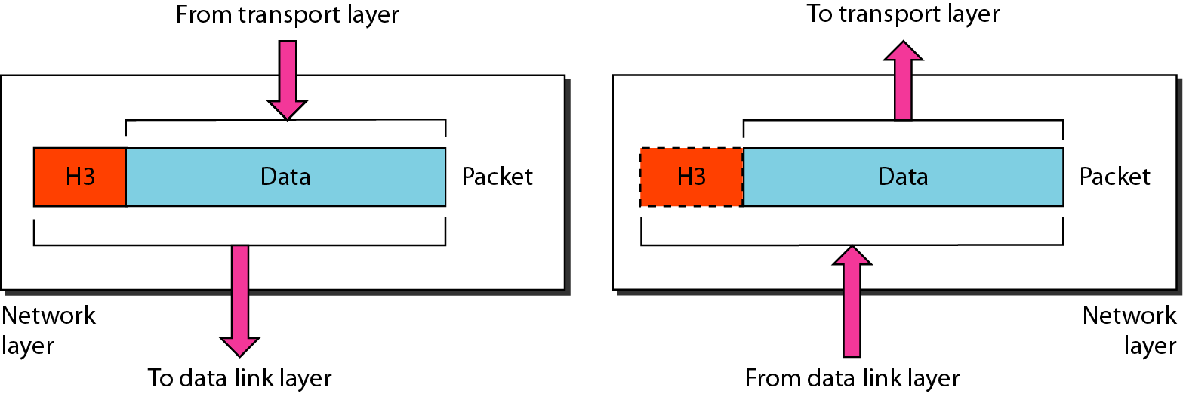
Network layer
Responsible for the delivery of individual packets from the source node to the destination node(s) (but, it may not guarantee the delivery!)
Logical addressing (of the sender/receiver)
Routing

Slide 11
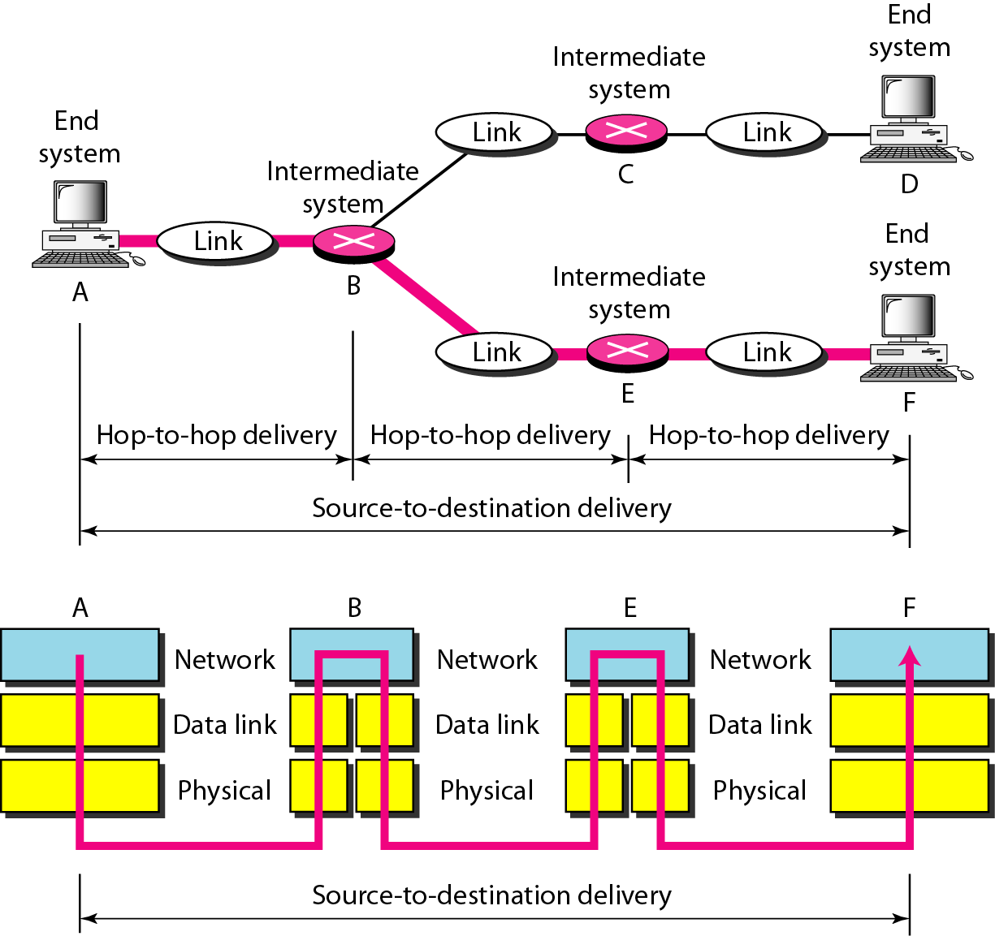
Network layer
Every host on the internet needs a way to get packets to other hosts outside its local network.
This requires special hosts called routers that can move packets between networks.
Packets may pass through many routers before they reach their destinations.

Slide 12
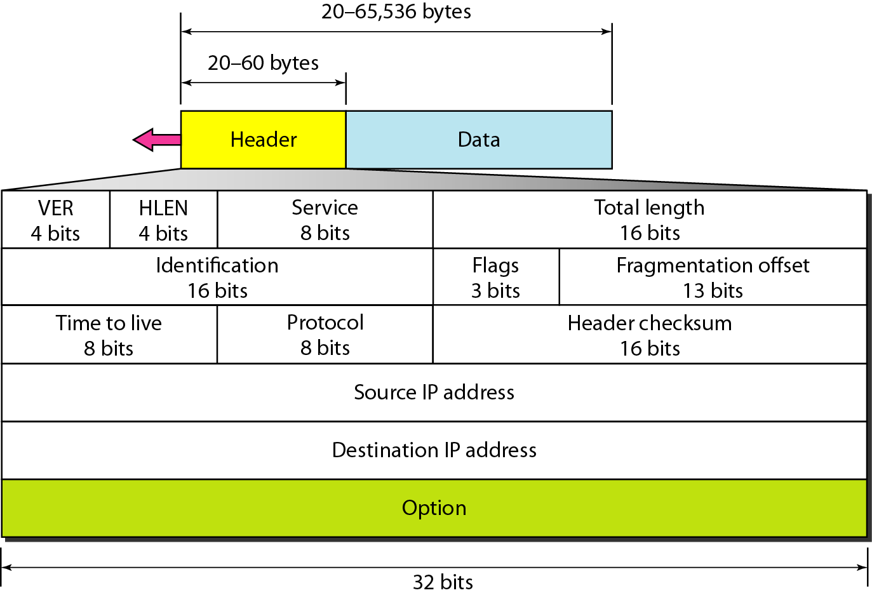
Network layer: IP packet structure
Header (20 ~ 60 bytes)
version
---------------
4 bits
HLEN
---------------
4 bits
Service
---------------
6 bits
ECN
---------------
2 bit
total length
---------------
16 bits
identification
---------------
16 bits
flags
---------------
3 bits
Value | Protocol
1 | ICMP
2 | IGMP
6 | TCP
7 | UDP
89 | OSPF
fragment offset
---------------
13 bits
time to live (TTL)
---------------
8 bits
protocol
---------------
8 bits
header checksum
---------------
16 bits
source address
---------------
32 bits
destination address
---------------
32 bits
options
---------------
32 bits
data
---------------
65535 bytes - header
Notes:
ECN − Explicit Congestion Notification; It carries information about the congestion seen in the route.
Flags − As required by the network resources, if IP Packet is too large to handle, these ‘flags’ tells if they can be fragmented or not. In this 3-bit flag, the MSB is always set to ‘0’.

Slide 13
Network layer: IP address
32 bit number (4 octet number) can be represented in lots of ways:
Decimal notation
Binary notation
Hexadecimal notation
133 | 27 | 162 | 125
10000101 | 00011011 | 10100010 | 01111101
85 | 1B | A2 | 7D

Slide 14
Network layer: key functions of a router
routing: determines src. – dst. route taken by packets (routing algorithms)
forwarding: move packets from router’s input to appropriate router output
routing algorithm
local forwarding table
1
header value
output link
3
2
0100
0101
0111
1001
3
2
2
1
0111
dest. address in arriving packet’s header

Slide 15
Network layer: Exercise
An IP packet has arrived with the first few hexadecimal digits as shown below:
4500 0028 0001 0000 0A06 0021 851B A27D 851B 8180..........
How many hops can this packet travel before being dropped?
What upper layer protocol the data belongs to?
Value | Protocol
1 | ICMP
2 | IGMP
6 | TCP
7 | UDP
89 | OSPF
flags
time to live
destination IP
total length
identification
frag. offset
checksum
HLEN
protocol
source IP
version
service
4 | 5 | 0 | 0028 | 0001 | 0 | 0 | 0A | 06 | 0021 | 851B A27D | 851B 8180

Slide 16
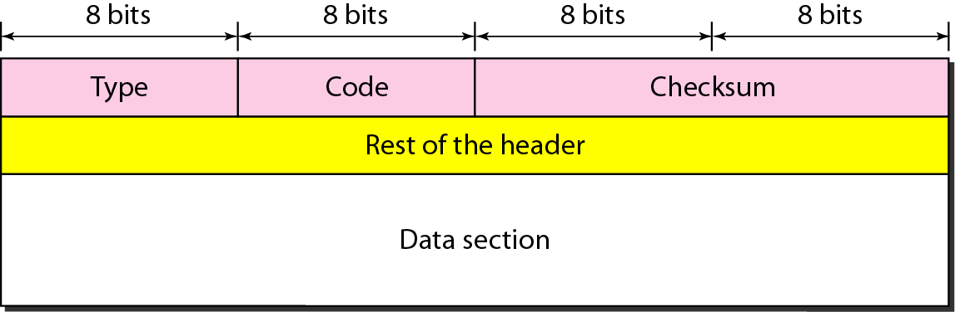
Internet Control Message Protocol
IP provides unreliable and connectionless datagram delivery. It lacks of error control and assistance mechanisms.
What happens if
a router must discard a datagram because it cannot find a route;
or time to live field has a zero value
the final destination host must discard all fragments of a datagram because it is not received all fragments, with a predetermined time limit.
Internet Control Message Protocol
Error-reporting (about a router or a host) or query message

Slide 17
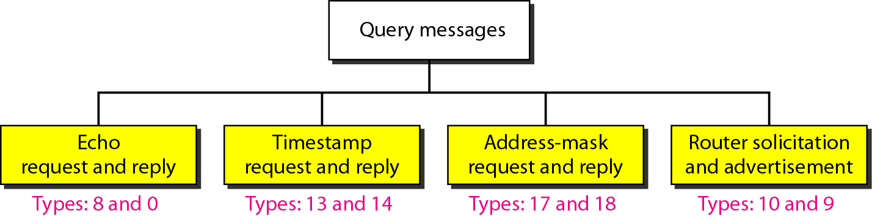
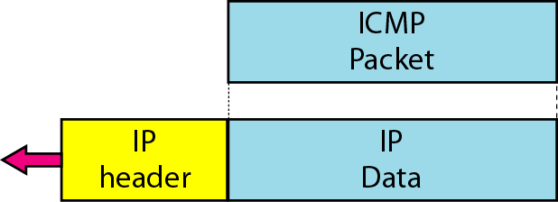
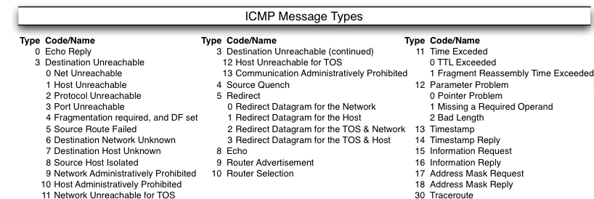
ICMP: Query Message
Encapsulation of query message

Slide 18
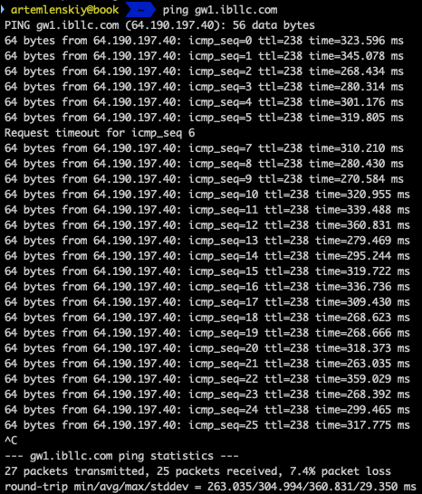
ping
ping operates by sending Internet Control Message Protocol (ICMP) echo request packets to the target host and waiting for an ICMP echo reply.
The program reports errors, packet loss, and a statistical summary of the results, typically including the minimum, maximum, the mean round-trip times, and standard deviation of the mean.

Slide 19
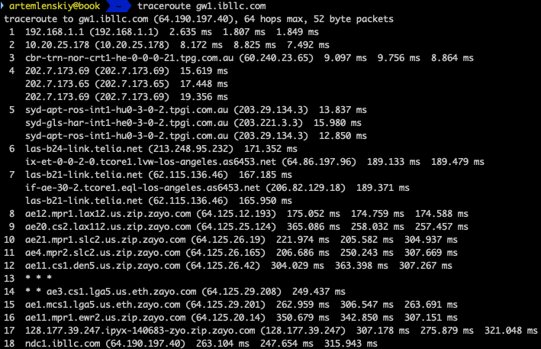
traceroute
traceroute (linux, mac osx) and tracert (windows) are computer network diagnostic commands for displaying the route (path) and measuring transit delays.
traceroute sends packets with TTL values that gradually increase from packet to packet, starting with TTL value of one. Routers decrement TTL values of packets by one when routing and discard packets whose TTL value has reached zero, returning the ICMP error message ICMP Time Exceeded.

Slide 20
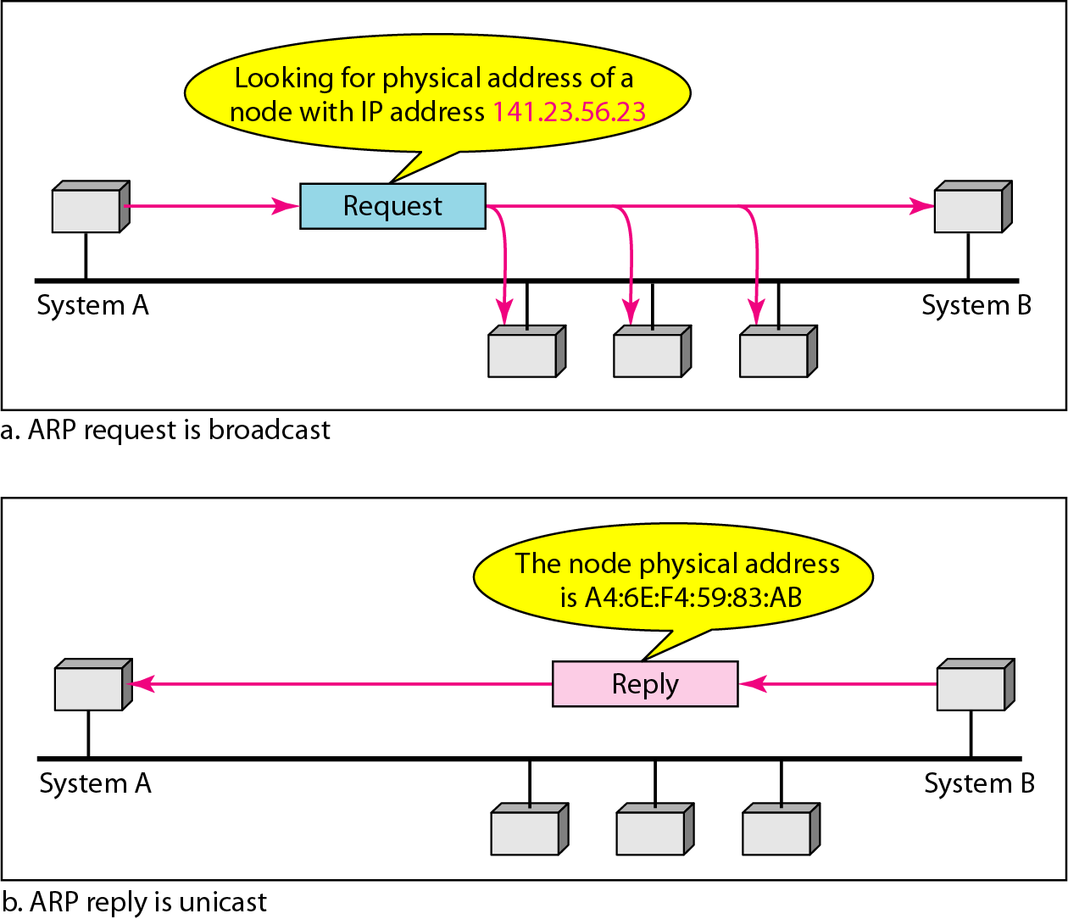
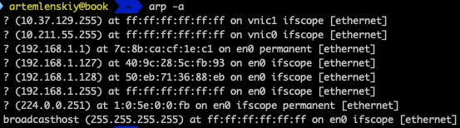
Address Resolution Protocol (ARP)
IP packets use logical address, and need to be encapsulated in a frame at data link layer, which requires physical address
Address Resolution Protocol (ARP) IPv4 is used , to map IP address to the hardware addresses used by a data link protocol
ARP request – broadcast
ARP reply – unicast
Information is cached at the sender

Slide 21
ARP attacks: man-in-the-middle-attack
An ARP attack can be directed at “cheating” a host computer or a network router. If a router has the wrong MAC address for a given IP address, then all communications are routed to the wrong host.
Alice is sent ARP responses continuously by the attacker claiming it is Bob, even though the victim never actually sent any request to the attacker
All ARP requests from Alice are redirected to the attacker, the forwarded to Bob
Bob is sent ARP responses from the attacker claiming that it is Alice.
All ARP requests from Bob are redirected to the attacker, the forwarded to Alice

Slide 22


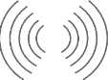
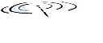


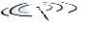



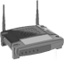

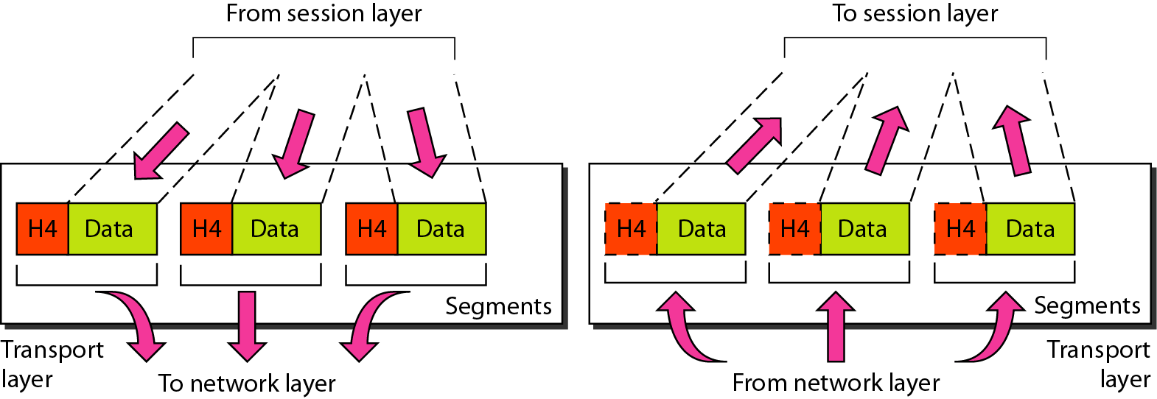


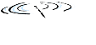


Transport-layer protocols
application
transport
network
data link
physical
transport protocols run in end systems
sender side: breaks app messages into segments, passes to network layer
receiver side: reassembles segments into messages, passes to app layer
service point addressing
reliable, in-order delivery (TCP)
congestion control
flow control
connection setup
unreliable, unordered delivery: UDP
no-frills extension of “best-effort” IP
services not available:
delay guarantees
bandwidth guarantees
logical end-end transport
from app. layer
to app. layer
application
transport
network
data link
physical

Slide 23
TCP/UDP segment structure
Sender sends and receiver receives IP datagrams
each datagram has source IP address, destination IP address
each datagram carries one transport-layer segment
each segment has source, destination port number
Host(OS) uses IP addresses & port numbers to direct segment to appropriate socket
TCP/UDP segment
header
source port
---------------
16 bits
Dest. port
---------------
16 bits
Other fields
Payload

Slide 24

Multiplexing/demultiplexing (key feature 1)
multiplexing at sender:
demultiplexing at receiver:
use header info to deliver received segments
to correct socket
handle data from multiple sockets, add transport header (later used for demultiplexing)
application
application
P1
P2
application
socket
P3
transport
P4
process
C
network
transport
transport
network
link
network
B
A
link
physical
link
physical
physical
A socket is bound to a port number so that the TCP layer can identify the application that data is destined to be sent to. Every network application has a unique port number.

Slide 25
Connection-oriented demux (key feature 1)
TCP socket identified by 4-tuple:
source IP address
source port number
destination IP address
destination port number
demux: receiver uses all four values to direct segment to appropriate socket
server host may support many simultaneous TCP sockets:
each socket identified by its own 4-tuple
web servers have different sockets for each connecting client
non-persistent HTTP will have different socket for each request (a nonpersistent connection is the one that is closed after the server sends the requested object to the client. In other words, the connection is used exactly for one request and one response.)

Slide 26
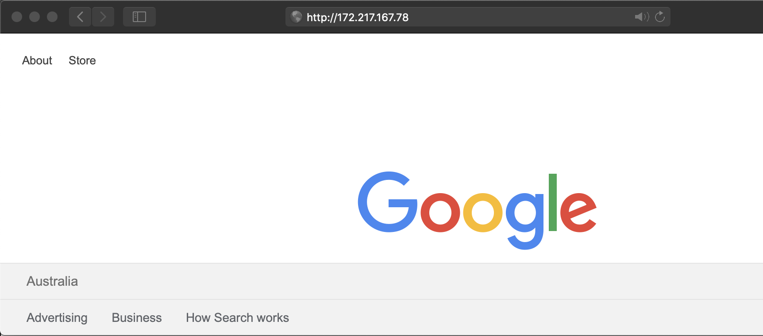
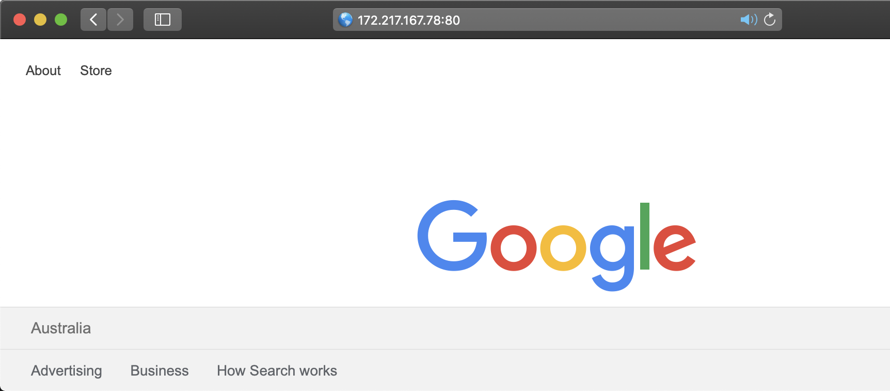
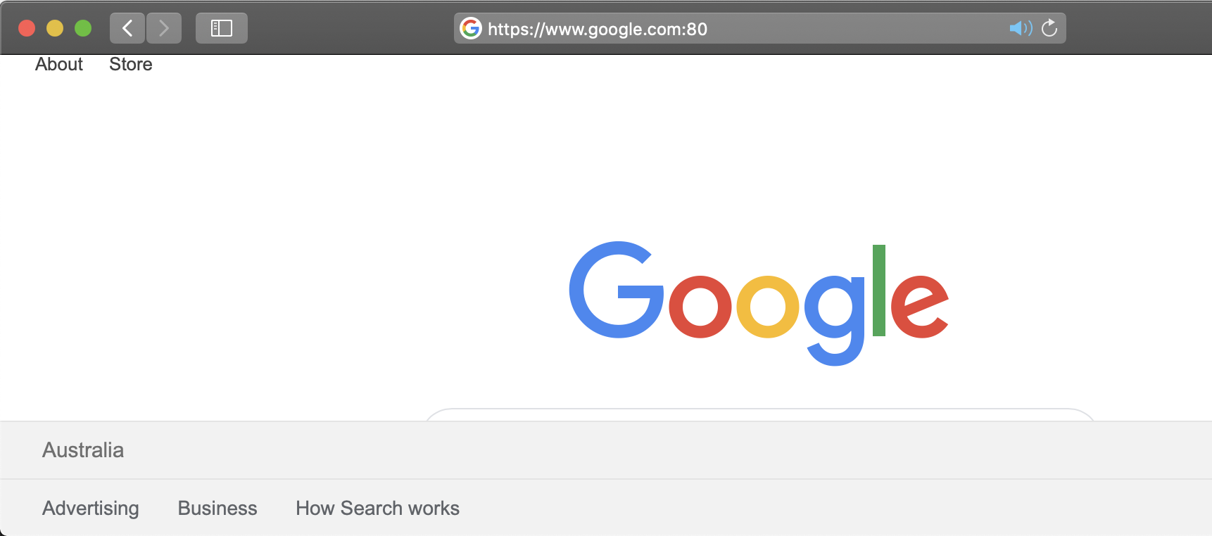
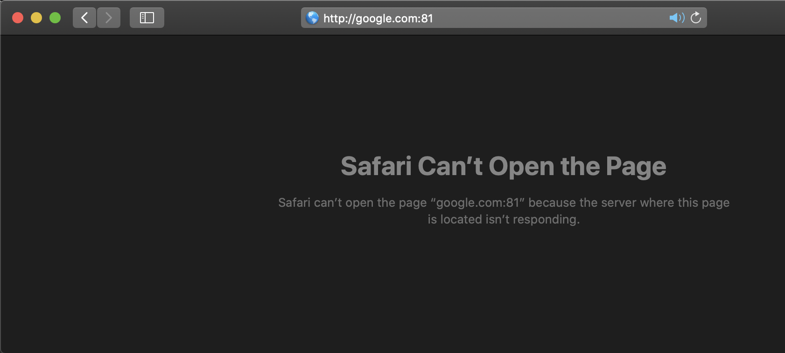
List of Well-Known Ports
port number | description
20 | FTP -- Data
21 | FTP -- Control
22 | SSH Remote Login Protocol
23 | Telnet
80 | HTTP
156 | SQL Server
443 | HTTPS
...

Slide 27
Example
three segments, all destined to (addr: B, dest port: 80) are demultiplexed to different sockets
server: IP address B
host: IP address A
application
host: IP address C
application
P4
P5
P6
application
P1
P2
P3
transport
transport
network
transport
network
link
network
link
physical
link
physical
physical
source IP, port: B,80
dest IP, port: A,9157
source IP, port: C, 5775
dest IP, port: B, 80
source IP, port: A, 9157
dest IP, port: B, 80
source IP, port: C,9157
dest IP, port: B,80

Slide 28
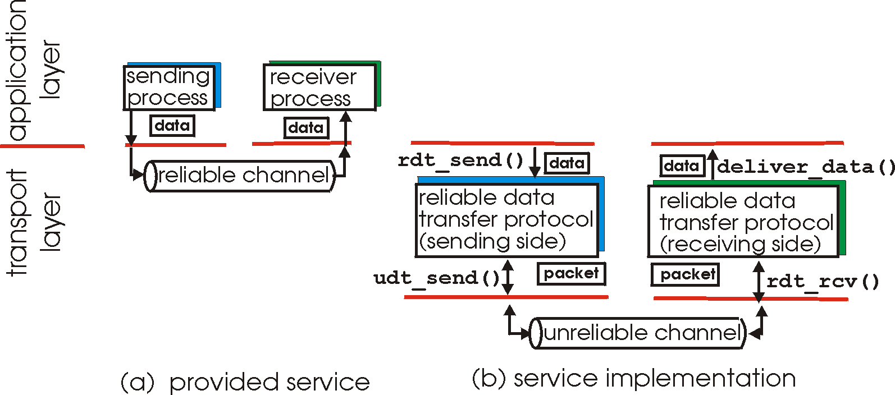
Principles of reliable data transfer (key feature 2)
application
layer
transport
layer
internet
layer
provided service
service implementation

Slide 29
TCP segment structure
header
source port
---------------
16 bits
Dest. port
---------------
16 bits
Other fields
Payload
sequence number
32 bits
acknowledgment number
32 bits
header length
4 bits
reserv.
6 bits
flags:
U A P R S F
6 bits
recv. window
16 bits
checksum
16 bits
Urg data ptr
16 bits
RST, SYN, FIN: connection establish (setup, teardown commands)

Slide 30
Connection Management (key feature 3)
before exchanging data, sender/receiver “handshake”:
agree to establish connection (each knowing the other willing to establish connection)
agree on connection parameters
application
application
connection state: ESTAB
connection variables:
seq # client-to-server
server-to-client
rcvBuffer size
at server,client
connection state: ESTAB
connection Variables:
seq # client-to-server
server-to-client
rcvBuffer size
at server,client
network
network
Socket clientSocket =
newSocket("hostname","port number");
Socket connectionSocket = welcomeSocket.accept();

Slide 31
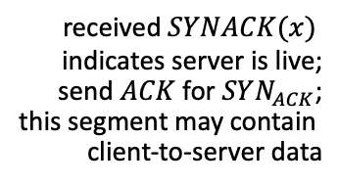
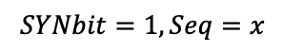
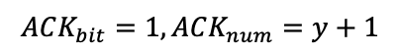
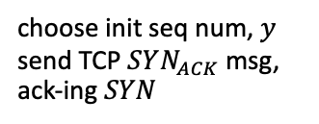
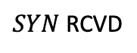
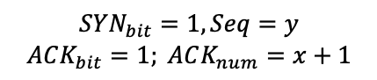
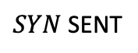
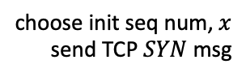
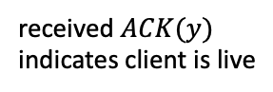
TCP 3-way handshake
client state
server state
LISTEN
LISTEN
choose init seq num, $x$
send TCP $SYN$ msg
$SYN$ SENT
$$SYNbit=1, Seq=x$$
choose init seq num, $y$
send TCP $SYN_{ACK}$msg, ack-ing $SYN$
$SYN$ RCVD
$$SYN_{bit}=1, Seq=y$$
$$ACK_{bit}=1; ACK_{num}=x+1$$
received $SYNACK(x)$
indicates server is live;
send $ACK$ for $SYN_{ACK}$;
this segment may contain
client-to-server data
ESTAB
$$ACK_{bit}=1, ACK_{num}=y+1$$
received $ACK(y)$
indicates client is live
ESTAB

Slide 32

(1) SYN flood attacks
under attack
client state
server state
LISTEN
LISTEN
choose init seq num, $x$
send TCP $SYN$ msg
$SYN$ SENT
choose init seq num, $y$
send TCP $SYN_{ACK}$msg, ack-ing $SYN$
$SYN$ RCVD
32

Slide 33
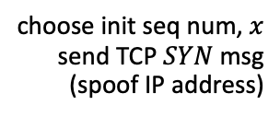
(2) SYN Flood attacks
under attack
client state
server state
LISTEN
LISTEN
choose init seq num, $x$
send TCP $SYN$ msg
(spoof IP address)
$SYN$ SENT
choose init seq num, $y$
send TCP $SYN_{ACK}$msg, ack-ing $SYN$
$SYN$ RCVD
under attack
https://www.cloudflare.com/learning/ddos/syn-flood-ddos-attack/
33

Slide 34
Complete network packet structure
ethernet frame
Ethernet header
-------------
14b
IP header
-------------
20b
TCP/UDP
header
-------------
20 bytes
payload
-------------
6 – 1460b
error check bits
-------------
4b
TCP payload
TCP segment / IP payload
IP packet / ethernet payload

Slide 35

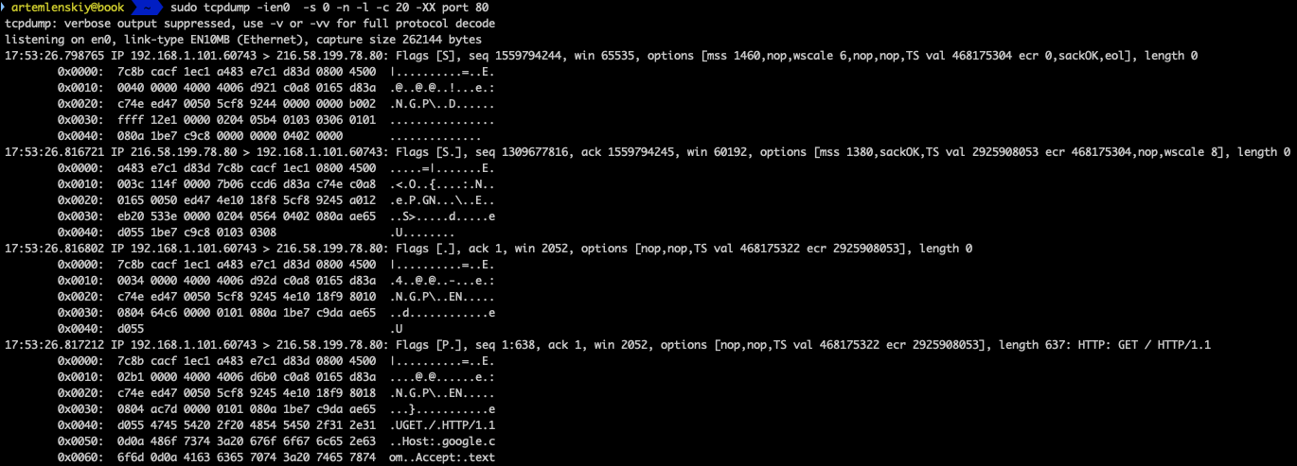
tcpdump
tcpdump command captures the live TCP/IP packets
Ethernet header
length
src mac address
IP header
TCP header
ver. & header length
src IP address
dst IP address
seq. num: 1559794244
control flags: 0x002 → 000000010 → SYN
Ptcl:TCP
TTL:64
dst
port: 80
Notes:
0050 5cf8 9244 000

Slide 36
tcpdump
Synchronize sequence numbers. Only the first packet sent from each end should have this flag set.
Push function. Asks to push the buffered data to the receiving application.

Slide 37
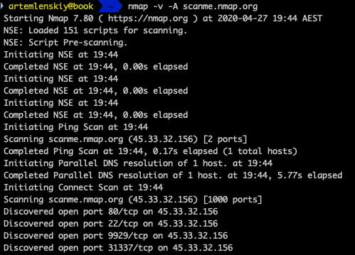
nmap
Nmap is used to discover hosts and services on a computer network by sending packets and analysing the responses.

Slide 38
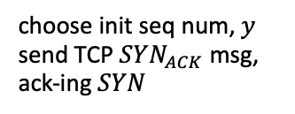
Create your own attacker
The key is to use design your own sockets (raw sockets)
Change source IP
Send a SYN TCP packet
under attack
client state
choose init seq num, $x$
send TCP $SYN$ msg
(spoof IP address)
choose init seq num, $y$
send TCP $SYN_{ACK}$msg, ack-ing $SYN$
under attack

Slide 39
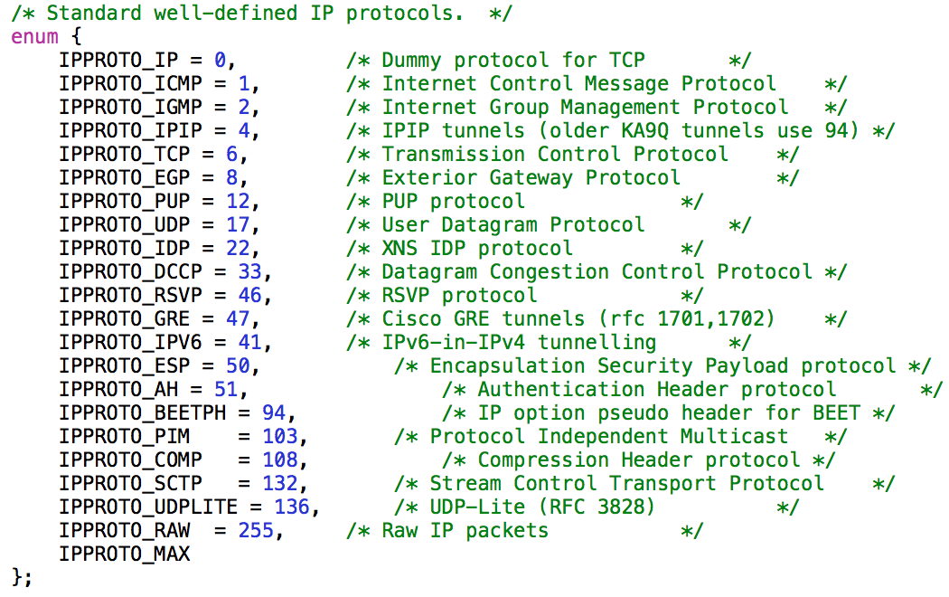
Creating raw sockets
int s = socket (PF_INET, SOCK_RAW, *int protocol*);
The 3rd argument: IPPROTO_XXX defines the actual protocol above IP.

Slide 40
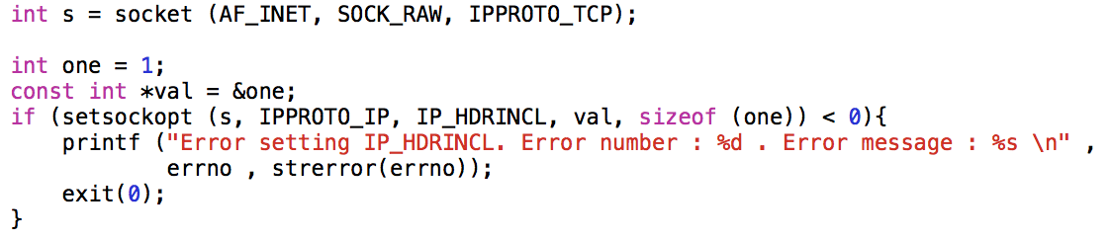
Creating raw sockets
We must provide the TCP header along with the data. The kernel or the network stack of Linux shall provide the IP header.
If we want to provide the IP header as well then there are 2 ways of doing this
Use protocol IPPROTO_RAW - This will allow to specify the IP header and everything that is contained in the packet.
Set the IP_HDRINCL socket option to 1.
When using the IP_HDRINCL the protocol used in the socket function is effectively of no use.

Slide 41
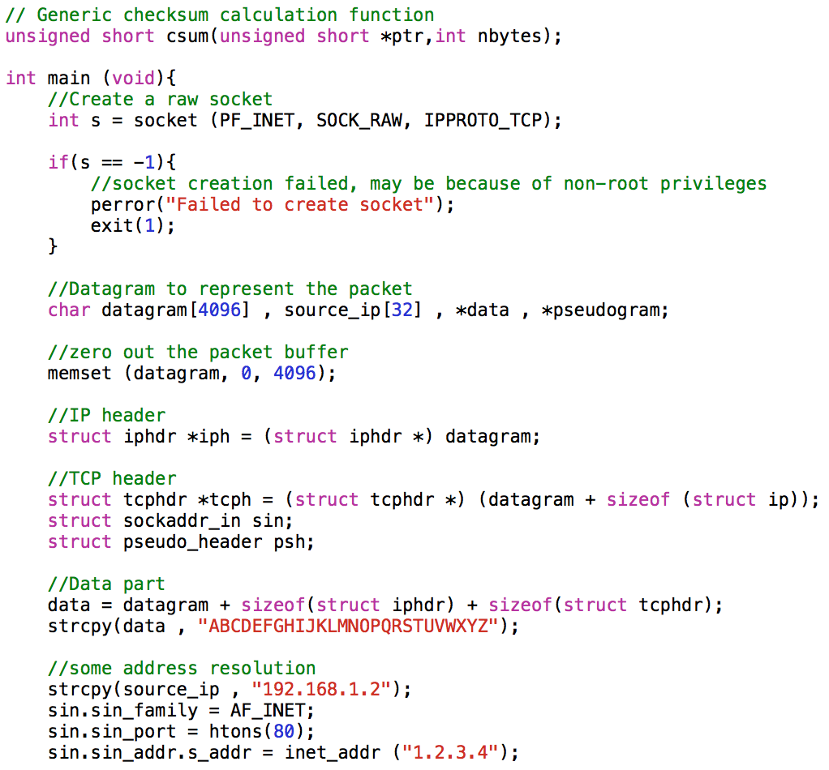
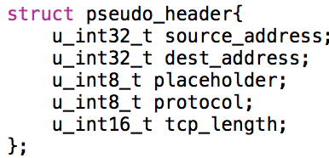
Creating raw sockets
96 bit (12 bytes) pseudo header needed for TCP header checksum calculation

Slide 42
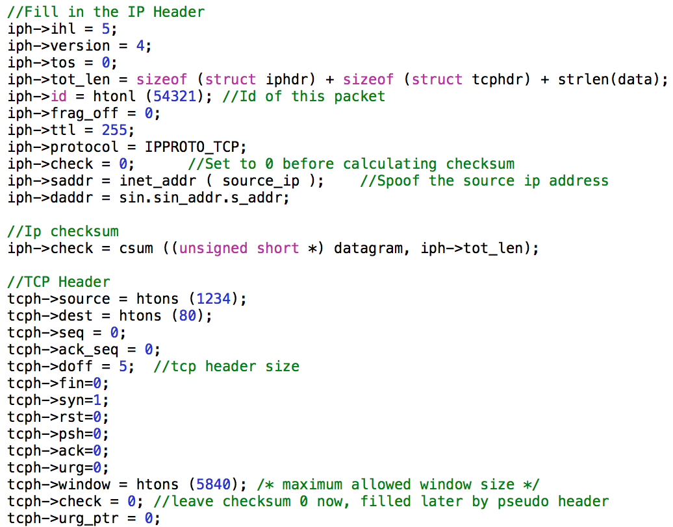
Creating raw sockets
Fill in IP and TCP headers

Slide 43
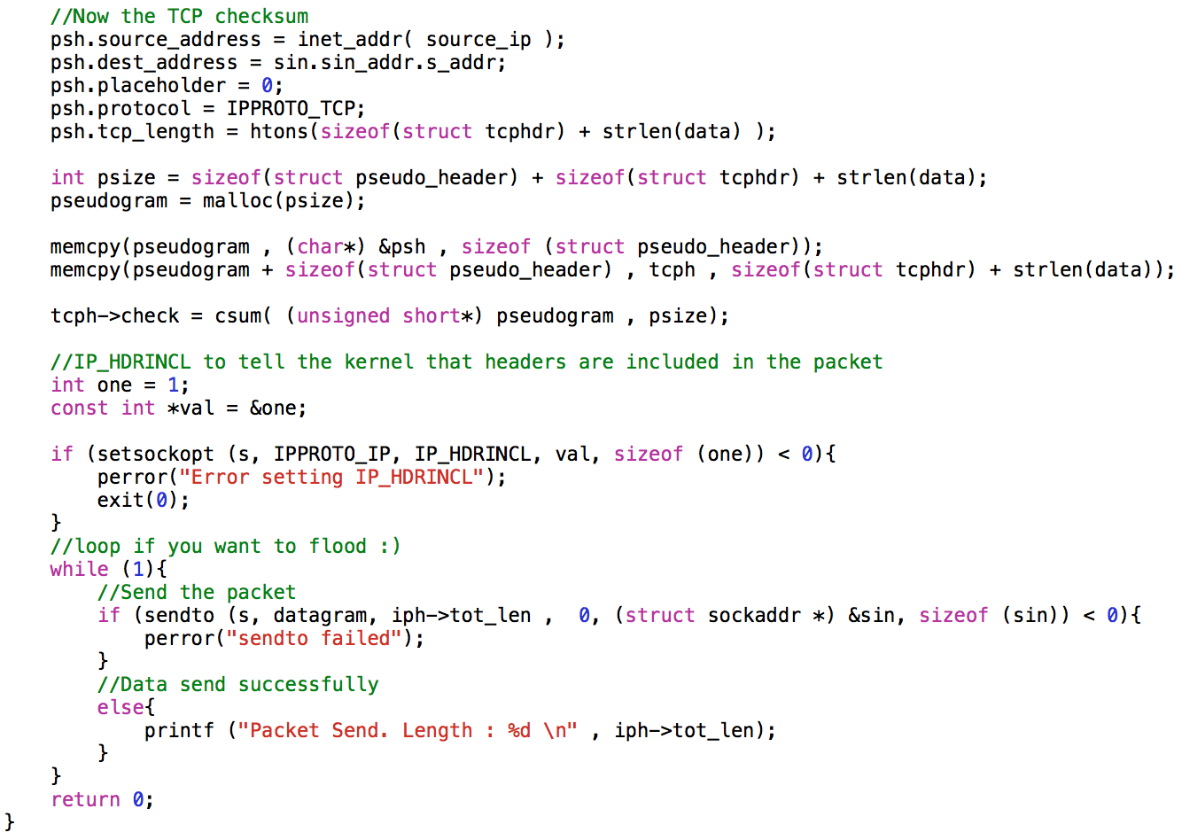
Creating raw sockets

Slide 44
Building and executing the attacker

Slide 45
Questions
Feel free to contact me by artem.lenskiy@anu.edu.au

Slide 46
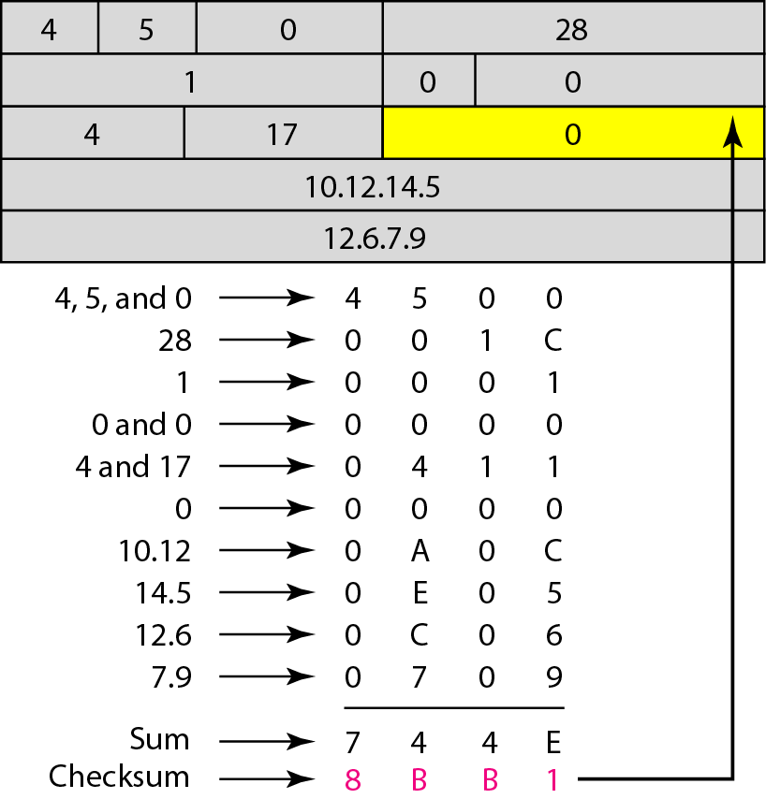

Appendix A: IP packet header checksum

